Slide 1
Cryptocurrency Price Predictor
Presented By,
Bharathkumara C N

Slide 2

What is Cryptocurrency?
A cryptocurrency (or crypto currency) is a digital asset designed to work as a medium of exchange using cryptography to secure the transactions and to control the creation of additional units of the currency.
Types of Cryptocurrency:
Bitcoin (BTC)
Ethereum (ETH)
Binance (BNB)
Cardano (ADA)
Litecoin (LTC)

Slide 3
Conventional vs Cryptocurrency
 | Conventional (Fiat) Currency | Cryptocurrency
Type | Real | Virtual
Intermediates | Yes | No (p2p)
Portability | Yes (except heavy cash) | Highly Portable
Decentralized | No | Yes
Secure | Moderate | High
Scarce | Low | High
Smart | No | Yes

Slide 4
Objective
There are many factors that affect the price of cryptocurrency such as, perceptions on its value by the public, Media, Investors, and Scams etc. In our model we statistically analyze historic values and social media sentiment to predict the market trends by using python libraries and functions.

Slide 5

Historic data analysis
Historical data analysis is the study of market behavior over a given period of time. The phrase "market behavior" is used in reference to the many different facets of the market and their interactions.
Sequential model is used to predict price of cryptocurrency.
We are using 100 epoch and 64 batch size to train the model.

Slide 6
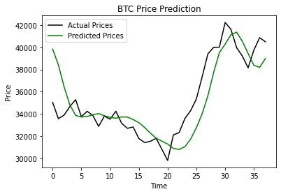
Historic data analysis

Slide 7
Sentiment Analysis
Sentiment analysis (or opinion mining) is a natural language processing technique used to determine whether data is positive, negative or neutral.
We have used Twitter as a social media platform to perform sentiment analysis on tweets regarding cryptocurrency.
Twitter API to access tweets in python (tweepy)
textBlob is used to perform Natural Language processing
Polarity – positive, negative and neutral

Slide 8
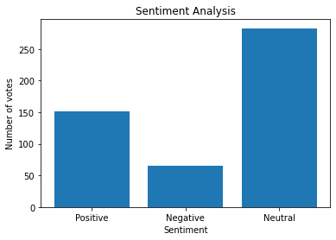
Sentiment Analysis

Slide 9
Python libraries used
TensorFlow
Sklearn
Tweepy
Textblob
Re
nltk
Pandas
Numpy

Slide 10
Conclusion
The heart and soul of Cryptocurrency is its price, which experiences erratic volatility in the market. The prediction of the price of cryptocurrency can not only make millionaires out of common men but can redefine the global economy as well. crypto prices can be predicted by the application of a variety of methods like machine learning, mathematics, Python programming, and more. Every method is complex, but the result is the generation of accurate buying and selling signals for Cryptocurrency.

